Slide 1




TravelTide
TravelTide
Data-Driven Personalized Perks to Improve Retention
Customer Segmentation
WITH THE STUDY PURPOSES
Created by Dr. Svitlana Kovalivska

Slide 2


TravelTide
TravelTide’s Business Landscape
Brief Overview: TravelTide is a leading e-booking platform launched in 2021, known for its best-in-class search and data aggregation.
Challenge: Despite a competitive advantage in inventory and technology, customer retention remains a challenge.
Goal: Implement a data-driven personalized rewards strategy to boost repeat bookings.

Slide 3
TravelTide
Overview
01
Introduction
05
Feature Engineering & Data Enhancements
09
Persona Portret
02
Problem
10
Perk Distribution & Impact
06
Data Cleaning & Handling Outliers
03
Strategic Objectives
11
Recommendation
07
Exploratory Data Analysis Insights
04
Data Extraction and Preparation
12
Conclusion
08
Data-Driven Customer Segmentation
Presented by Dr. Svitlana Kovalivska

Slide 4
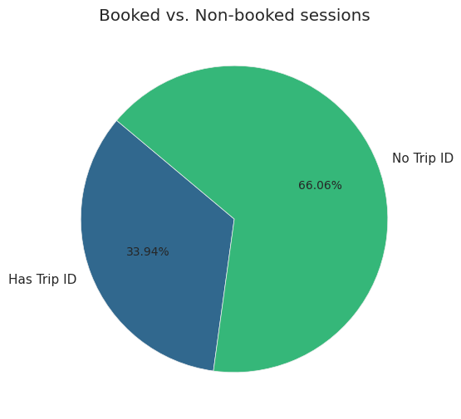
TravelTide
TravelTide
Problem
TravelTide, a fast-growing e-booking platform launched in 2021, excels in travel search and data aggregation but faces challenges in customer retention. A data-driven rewards strategy that personalizes incentives based on customer behaviour was developed to strengthen loyalty and engagement.

Slide 5
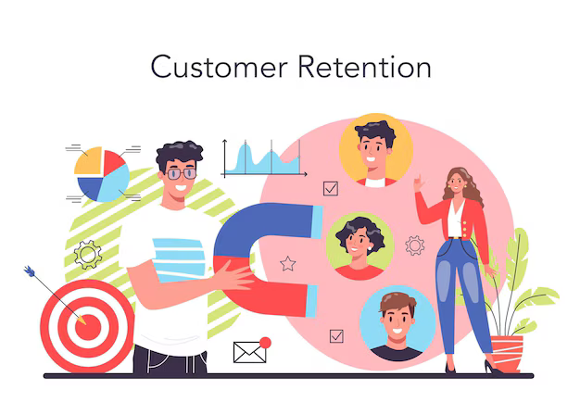
TravelTide
TravelTide
Strategic Objectives
Enhance Retention: Offer targeted, high-value perks based on travel behavior.
Improve Conversion Rates: Replace generic rewards with personalized offers.
Create a Competitive Edge: Leverage customer insights to increase engagement.

Slide 6
TravelTide
Data Extraction and Preparation
Data Sources:
Preprocessing:
Feature Engineering:
Travel sessions, booking history, and customer profiles from PostgreSQL.
Data cleaning, missing value imputation, outlier detection.
Travel patterns, behavioral signals, spending habits.

Slide 7
TravelTide
Feature Engineering & Data Enhancements
Overview
Key Features Added:
Introduced more then 20 New Features to improve customer profiling and perk assignment.
Fare per Seat: More accurate relative ticket pricing instead of Base Fare.
Lead Time to Departure: Measures how far in advance bookings are made.
Booking Frequency: Tracks number of bookings within the last 6/12 months.
Average Trip Duration: Helps differentiate between short-term vs. long-haul travelers.
Flight-to-Hotel Ratio: Identifies whether a user books flights alone or as packages.
Cancellation Rate: Determines risk of cancellations for flexible booking perks.
Engagement Score: Based on session duration, clicks, and search activity.

Slide 8
TravelTide
01
Outlier Detection:
Data Cleaning & Handling Outliers
Identified extreme booking behaviors, such as unusually high spending or frequent cancellations.
Used Interquartile Range (IQR) and Z-score methods to flag outliers.
Special segmentation applied for high-value travelers (luxury segment).
02
Handling Negative Night Stays:
Detected anomalies in check-in and check-out dates (e.g., negative nights due to reversed timestamps).
Corrected by swapping incorrect values or removing invalid records.
Ensured clean and reliable data before clustering.

Slide 9
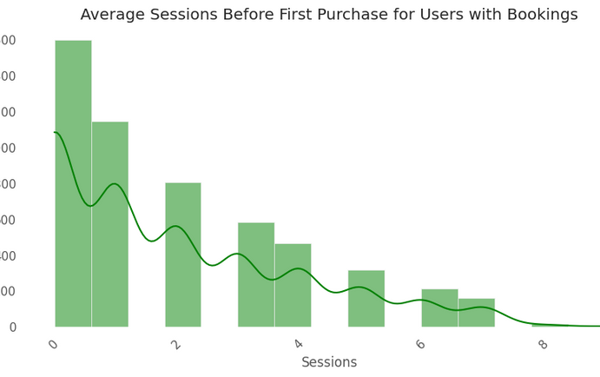
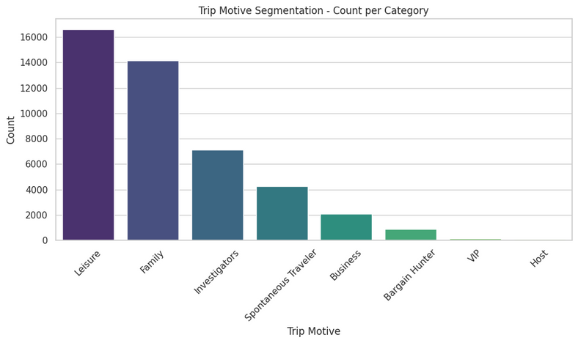
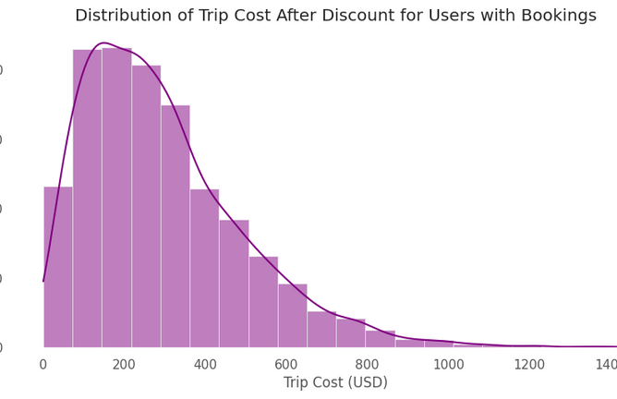
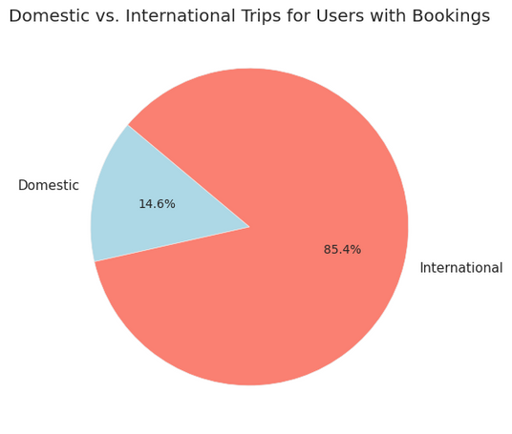
TravelTide
Exploratory Data Analysis Insights
Booking Trends: Majority of users browse but don’t convert.
Engagement Metrics: Click rate, session duration, and lead time analyzed.
Customer Behavior Groups: Identified trends in cost sensitivity, flexibility, and travel frequency.

Slide 10
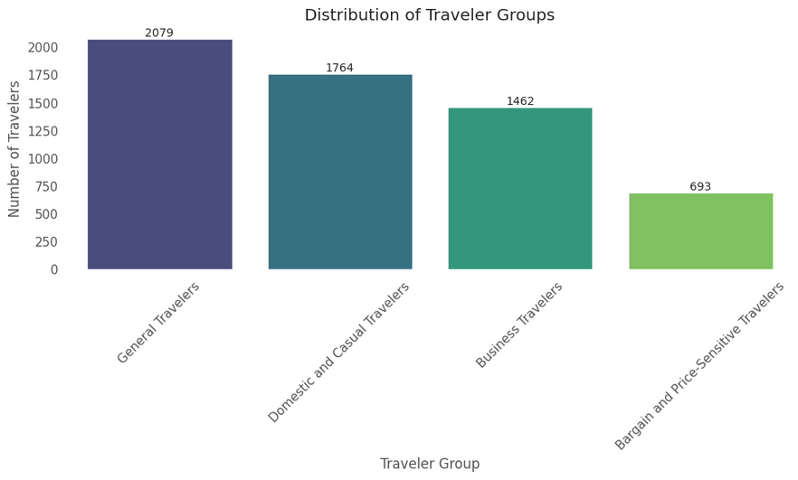
TravelTide
Data-Driven Customer Segmentation
KMeans clustering identified six traveler segments, later consolidated into four primary groups:
Methodology, Technologies Used:
Python (Pandas, NumPy, Scikit-learn, Matplotlib, Seaborn) for data processing, clustering, and visualization.
SQL (PostgreSQL) for data extraction and transformation.
Machine Learning (KMeans clustering, PCA for dimensionality reduction) for customer segmentation.

Slide 11
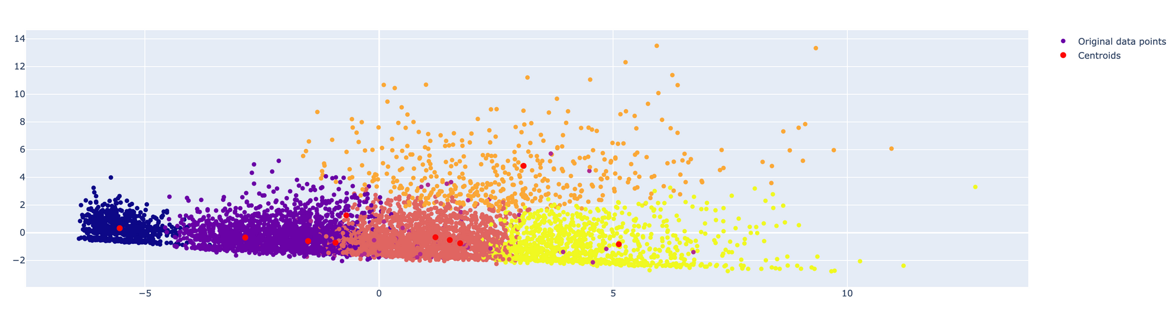
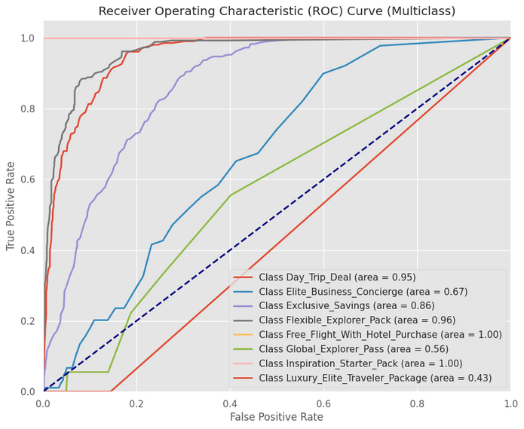
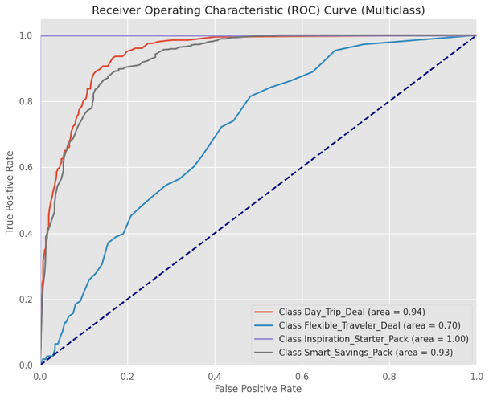
TravelTide
Clusters

Slide 12
TravelTide
Persona Portret
Business Traveler
Bargain and Price-Sensitive Traveler
General Traveler
User 101961
Gender and Age: Female, 42 years old.
User Since: 2022.
Travel History: 10 flights and 5 hotel stays via TravelTide.
Travel Characteristics:
Short stays: average hotel stay duration is 3 nights.
Minimal luggage: 25% flights with carry-on only.
Behavior: Prioritizes efficiency and minimizing travel time.
Recommended Perk: VIP Lounge & Priority Check-In.
User 844489
Gender and Age: Male, 23 years old.
User Since: 2023.
Travel History: No trips booked through TravelTide.
Characteristics:
Highly interested in deals and discounts.
Prefers budget hotels and economy-class flights.
Flexible with travel dates to secure better prices.
Behavior: Extremely price-sensitive, responds well to discounts.
Recommended Perk: 20% Off First International Booking.
User 174997
Gender and Age: Female, 31 years old.
User Since: 2020.
Travel History: 4 flights and 2 hotel stays via TravelTide.
Travel Characteristics:
Travels for leisure, including international trips.
Values flexibility: often books refundable tickets.
Books both hotels and flights together.
Behavior: Enjoys traveling but prefers flexibility when booking. Moderate spending level.
Recommended Perk: General 5% Travel Discount.

Slide 13
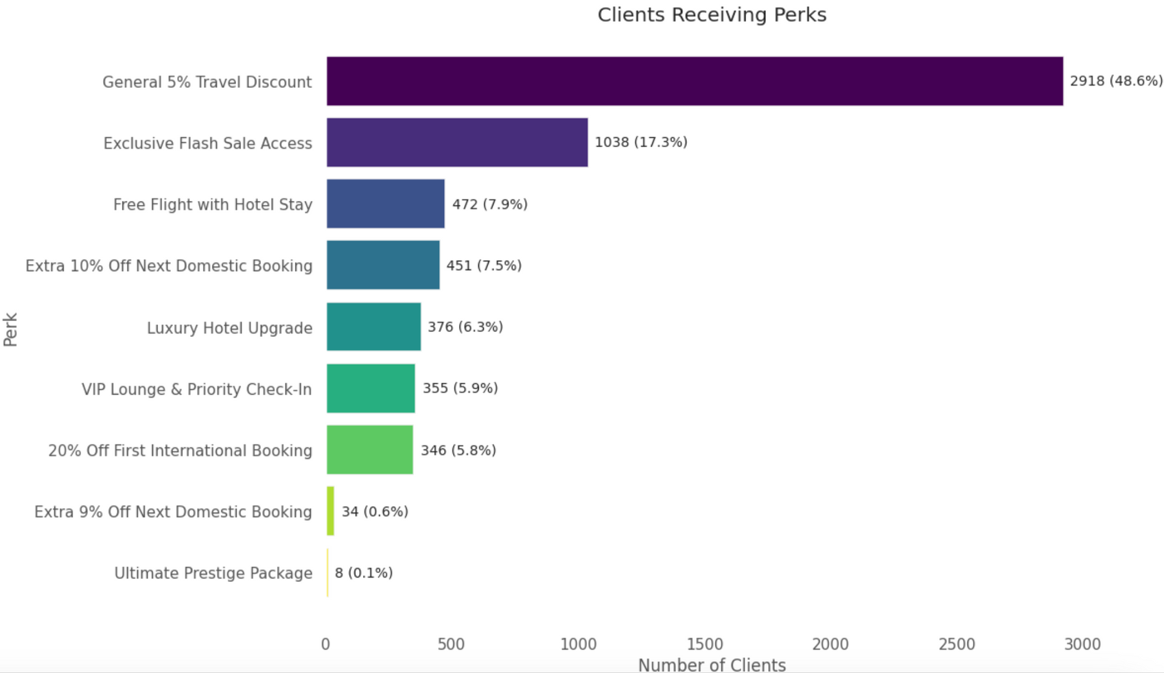
TravelTide
Perk Distribution & Impact

Slide 14
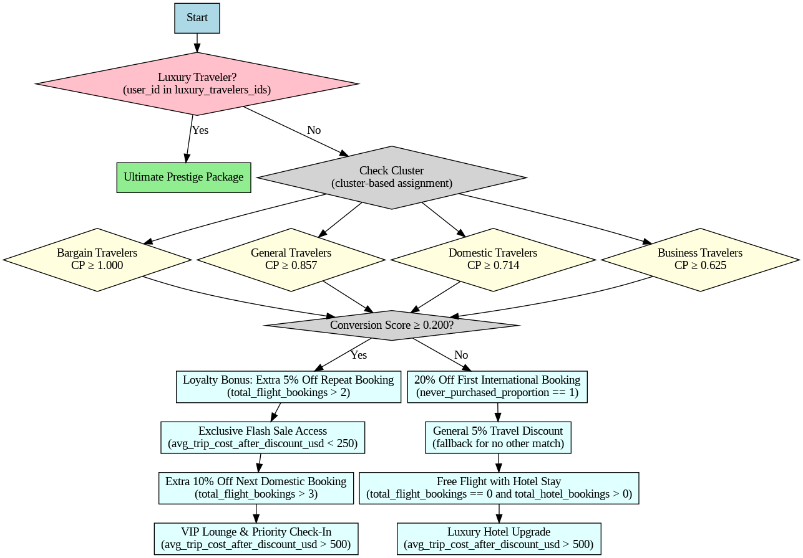
TravelTide
TravelTide
Key Results & Perk Assignment Insights

Slide 15
TravelTide
Recommendations & Next Steps
Testing & Optimization Strategy
Implementation Strategy
A/B Testing: Comparing personalized emails vs. generic rewards emails.
Key Metrics Monitored: Click-through rates, conversion rates, and booking frequency.
Expected Outcome: Higher engagement and increased loyalty with personalized perks.
Launch Personalized Perk-Based Email Campaigns.
Conduct A/B Testing on Reward Effectiveness.
Monitor and Continuously Optimize Perk Assignments.

Slide 16
TravelTide
Conclusion & Business Impact
Key Takeaways:
Data-driven personalization improves customer retention.
01
Segmentation allows for tailored marketing efforts.
02
Perk optimization leads to increased customer loyalty and conversion.
03
Next Steps: Implement, measure, and optimize the rewards strategy.

Slide 17
TravelTide
Presented by Dr. Svitlana Kovalivska
Thank You
Personalized rewards are the future of TravelTide’s customer retention strategy

